Slide 1

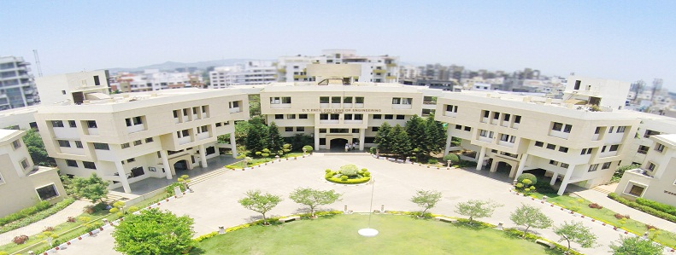
D. Y. Patil College of Engineering, Akurdi, Pune
Project Based Learning(PBL) Presentation
on
Title
Presented By:
Name
Seat No
Guided by:
Guide Name

Slide 2

Overview
Background
Introduction
Literature Survey
Motivation
…….

Slide 3
Motivation
For Example:
Speedy growth in the amount of generating e-learning data.
Time Consuming Process
Content based Retrieval

Slide 4
Objective

Slide 5
Introduction
Example Data:
Digital video has become a popular storage and exchange medium.
Recording Technology
Improved video compression techniques
High-speed networks

Slide 6
Literature Survey
No | Title | Author | Journal | Description
1 | Example: Content Based Lecture Video Retrieval Using Speech and Video Text Information | Haojin Yang and Christoph Meinel, Member. | IEEE TRANSACTIONS ON LEARNING TECHNOLOGIES, APRIL-JUNE 2014 | presents an approach for automated video indexing and video search in large lecture video archives
2
3

Slide 7
Problem Description
Problem Statement:
Example:
To improve the search and navigation feature of lecture video, metadata is extracted using video analysis method for efficient and effective search mechanism within a lecture video.
Problem Solution

Slide 8
Proposed System
Figure 1: System Architecture Diagram

Slide 9
System Block Diagram

Slide 10
Data Flow Diagram/ER Diagram

Slide 11
Implementation Details

Slide 12
Conclusion
Example:
Presented an approach for content-based lecture video indexing and retrieval in lecture video archives.
We have proposed a method of textual metadata extraction from slide frames through analysis technique.
……

Slide 13
References
For Example:
[1] Xiaoyin Che, Haojin Yang, and Christoph Meinel. Lecture video segmentation by automatically analyzing the synchronized slides. In Proceedings of the 21st ACM international conference on Multimedia, pages 345–348. ACM, 2013.
[2] Boris Epshtein, Eyal Ofek, and Yonatan Wexler. Detecting text in natural scenes with stroke width transform. In Computer Vision and Pattern Recognition (CVPR), 2010 IEEE Conference on, pages 2963–2970. IEEE, 2010.
.

Slide 14

THANK YOU

